Slide 1

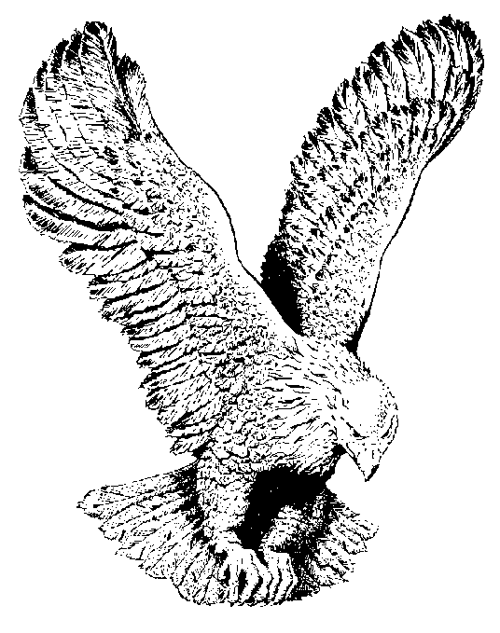
488 HOLY GROUND
Holy ground, we’re standing on Holy ground,
Lord of lords is He, and where He is, is Holy;
Holy ground, we’re standing on holy ground,
Lord of lords is He, and where He is, is Holy;
…Holy hand, we’re lifting up holy hands…

